Slide 1
Computer Vision
Fall 2018
Problem Set #5
Junle Lu
junle.lu@gatech.edu
Computer Vision @ GT

Slide 2
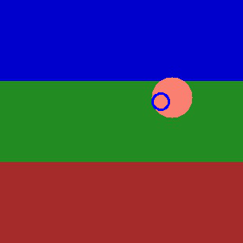
1b: KF Tracking a circle
ps5-1-b-1.png
Computer Vision @ GT

Slide 3
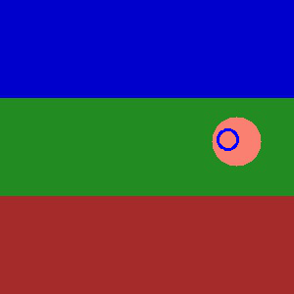
1b: KF Tracking a circle (cont.)
ps5-1-b-2.png
Computer Vision @ GT

Slide 4
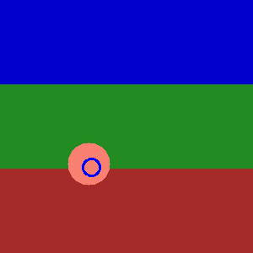
1b: KF Tracking a circle (cont.)
ps5-1-b-3.png
Computer Vision @ GT

Slide 5
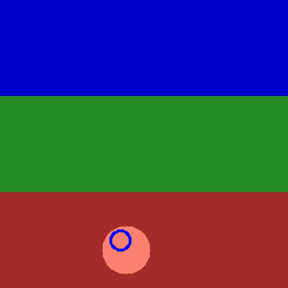
1b: KF Tracking a circle (cont.)
ps5-1-b-4.png
Computer Vision @ GT

Slide 6
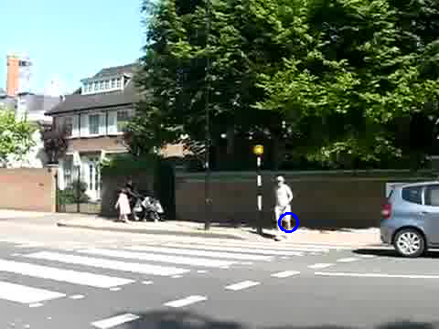
1c: KF Tracking pedestrians
ps5-1-c-1.png
Computer Vision @ GT

Slide 7
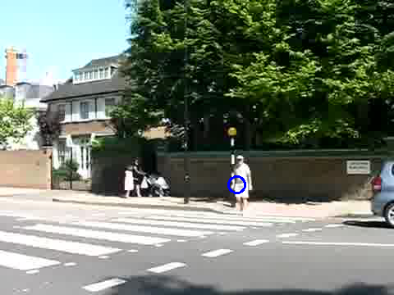
1c: KF Tracking pedestrians
ps5-1-c-2.png
Computer Vision @ GT

Slide 8
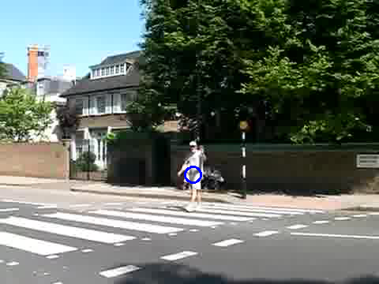
1c: KF Tracking pedestrians
ps5-1-c-3.png
Computer Vision @ GT

Slide 9
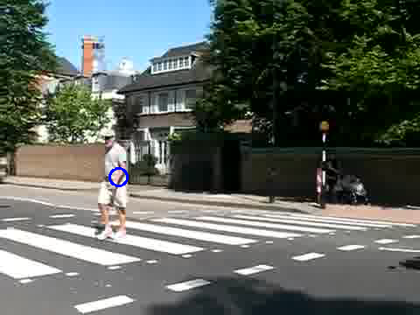
1c: KF Tracking pedestrians
ps5-1-c-4.png
Computer Vision @ GT

Slide 10

2a: PF Tracking a circle
ps5-2-a-1.png
Computer Vision @ GT

Slide 11

2a: PF Tracking a circle (cont.)
ps5-2-a-2.png
Computer Vision @ GT

Slide 12
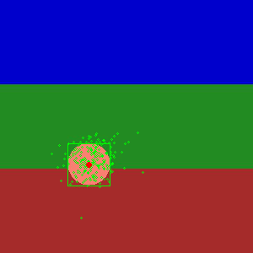
2a: PF Tracking a circle (cont.)
ps5-2-a-3.png
Computer Vision @ GT

Slide 13

2a: PF Tracking a circle (cont.)
ps5-2-a-4.png
Computer Vision @ GT

Slide 14
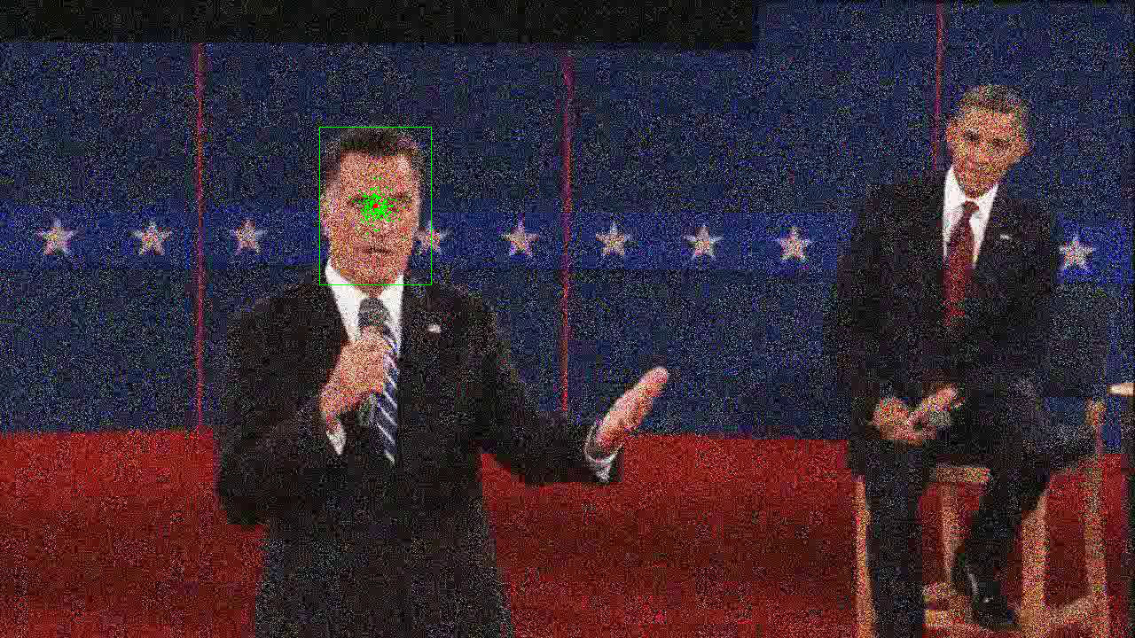
2b: PF Tracking noisy video
ps5-2-b-1.png
Computer Vision @ GT

Slide 15
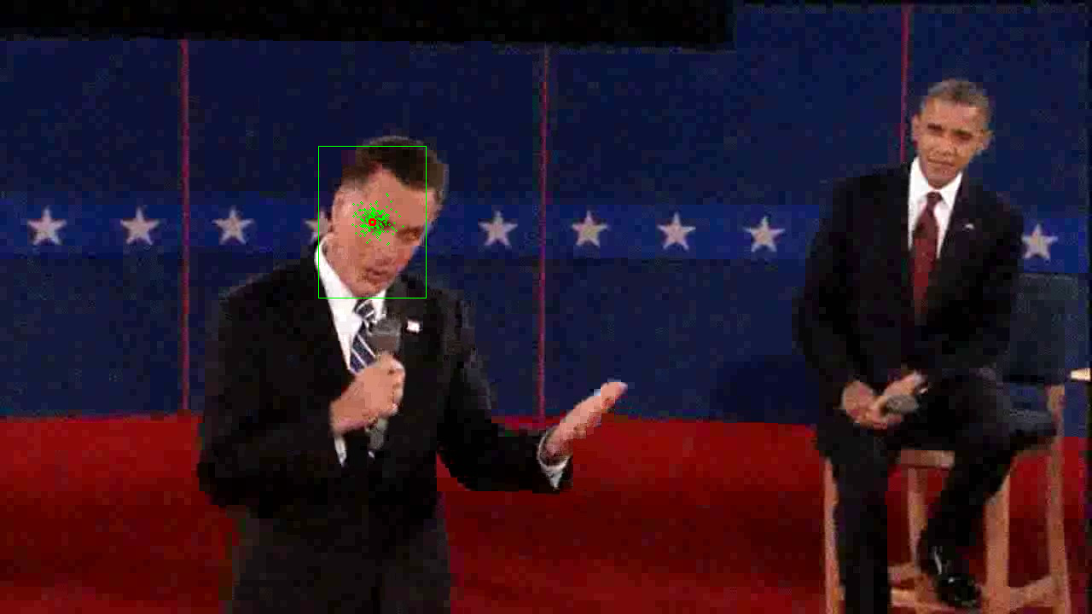
2b: PF Tracking noisy video (cont.)
ps5-2-b-2.png
Computer Vision @ GT

Slide 16
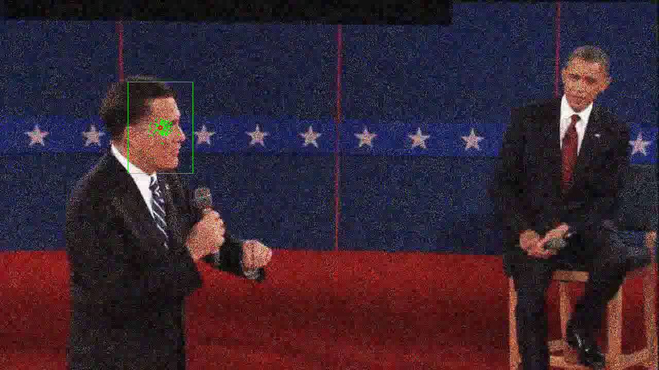
2b: PF Tracking noisy video (cont.)
ps5-2-b-3.png
Computer Vision @ GT

Slide 17
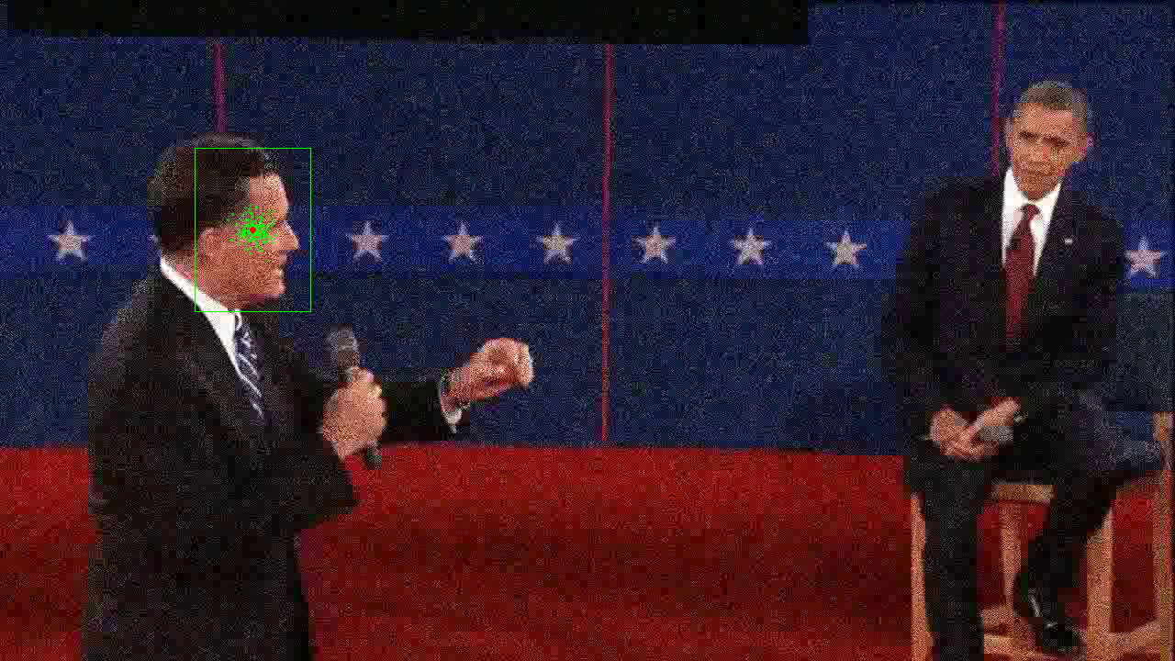
2b: PF Tracking noisy video (cont.)
ps5-2-b-4.png
Computer Vision @ GT

Slide 18
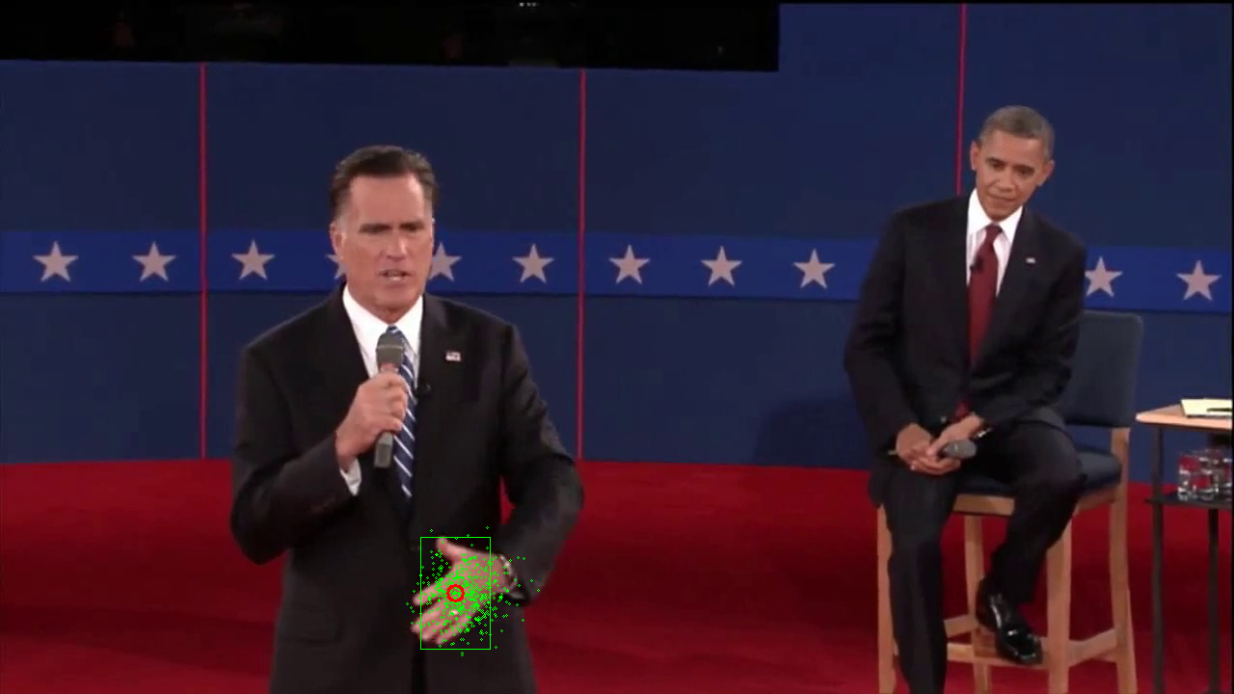
3a: PF Changes in Appearance
ps5-3-a-1.png
Computer Vision @ GT

Slide 19
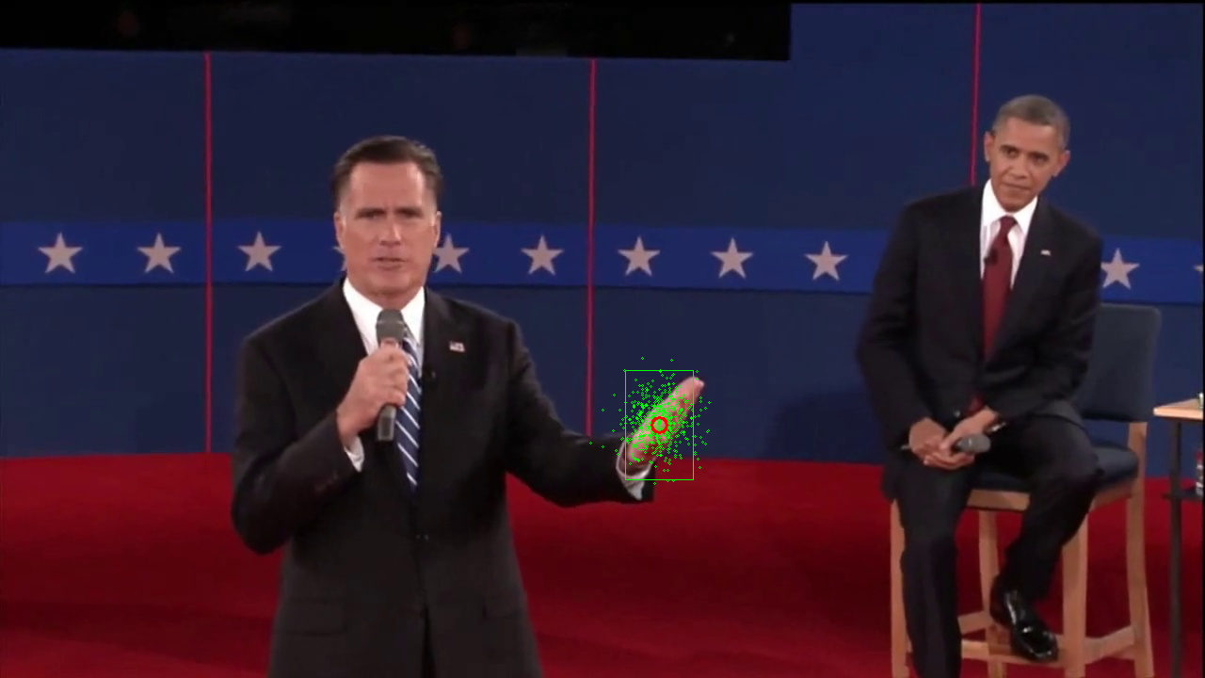
3a: PF Changes in Appearance (cont.)
ps5-3-a-2.png
Computer Vision @ GT

Slide 20
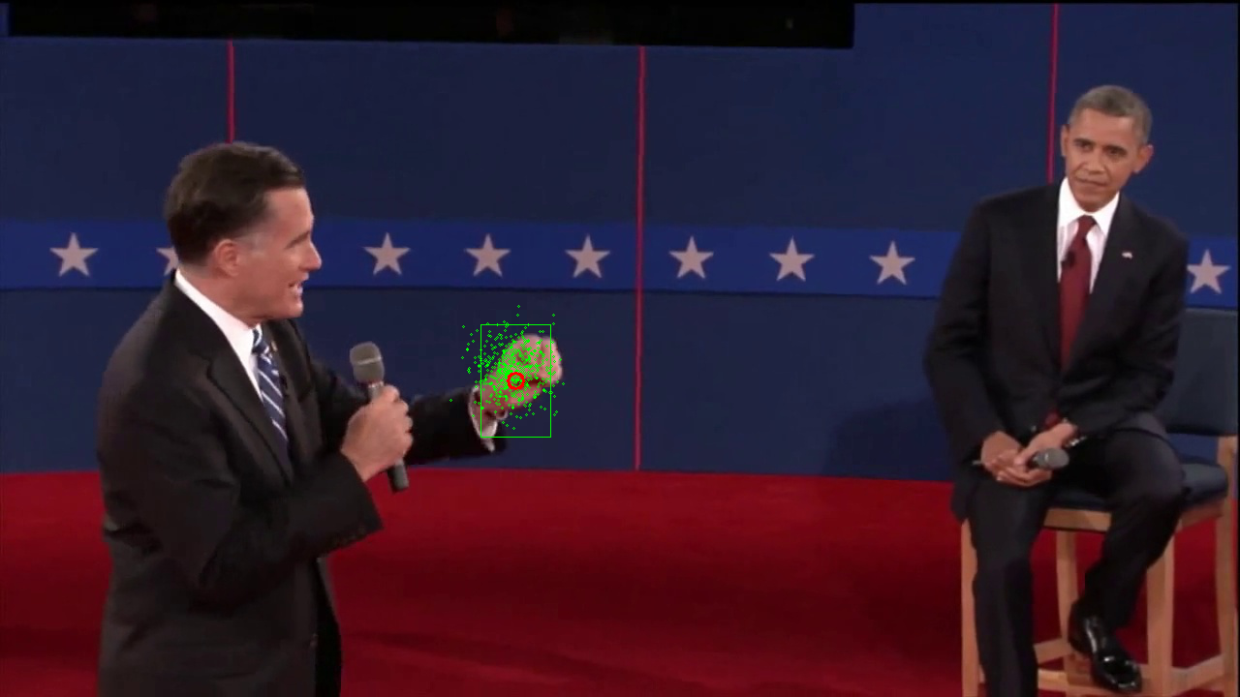
3a: PF Changes in Appearance (cont.)
ps5-3-a-3.png
Computer Vision @ GT

Slide 21
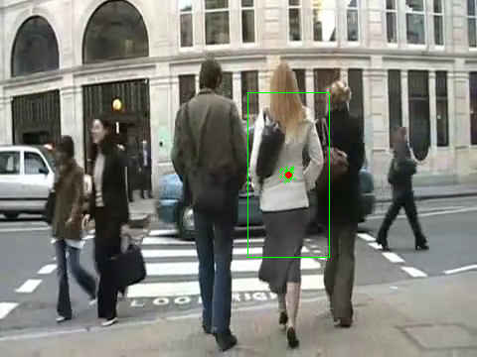
4a: PF Occlusions
ps5-4-a-1.png
Computer Vision @ GT

Slide 22
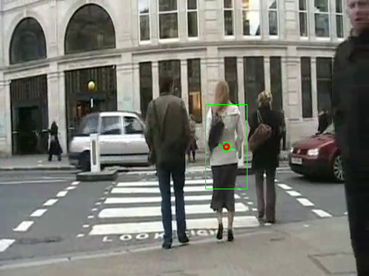
4a: PF Occlusions (cont.)
ps5-4-a-2.png
Computer Vision @ GT

Slide 23
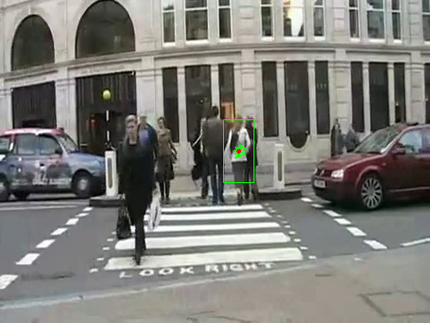
4a: PF Occlusions (cont.)
ps5-4-a-3.png
Computer Vision @ GT

Slide 24
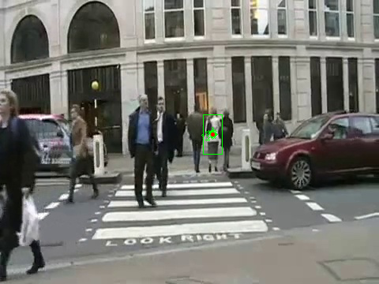
4a: PF Occlusions (cont.)
ps5-4-a-4.png
Computer Vision @ GT

Slide 25
4: Text response
I added another state ‘scale’ to the particles to scale the template image as needed. The scale state was added with gaussian noise (just as x,y states) with sigma value 0.01, which is good number for the moving speed of the lady. At every iteration, the size of template is resized (cv2.resize) with the weighted mean of the ‘scale’ state value. But there is a threshold to prevent it from resizing during occlusions. For occlusions, I computed the mean square error between the resized template and the previous template. If the error is over the threshold, then the resized template may not be accurate. The appearance of the template is not accounted here, as there isn’t much change in appearance in this case. Therefore, the filter can be applied on moving object (change in size) and occlusions.
The parameter tuning was required to make it to work. First of all, the motion model sigma and number of particles are kept small. The reason is that, the occlusions have greater effect with more particles that more spared. Then, the mean square error for template model update (threshold) can be tuned to make sure that it is not resize the template when there is occlusions. This parameter tuning was repeated until satisfactory results.
Computer Vision @ GT

Slide 26
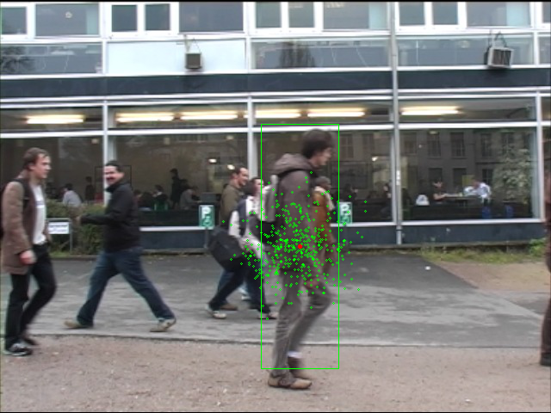
5: Tracking multiple targets
ps5-5-a-1.png
Computer Vision @ GT

Slide 27
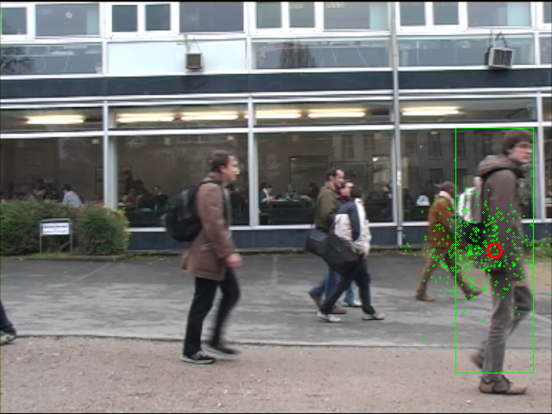
5: Tracking multiple targets (cont.)
ps5-5-a-2.png
Computer Vision @ GT

Slide 28
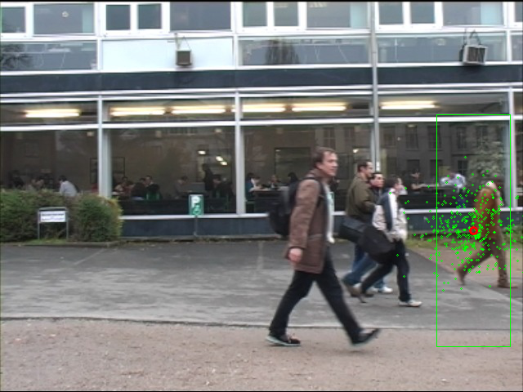
5: Tracking multiple targets (cont.)
ps5-5-a-3.png
Computer Vision @ GT

Slide 29
5: Text response
I did not complete this task. I think particle filer would be easier to implement than Kalman filter. It could be done with three filters to track the three students respectively. These three are similar features and may be difficult to keep on tracking the target. There is occlusion when the two students crossed each other. One solution could be to include the velocity states and follows, so that the tracker can follow along with the student. The frame can also be preprocessed for each filter to make the targets easier to track.
Computer Vision @ GT

Slide 30
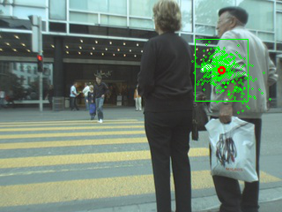
6: Challenge Problem
ps5-6-a-1.png
Computer Vision @ GT

Slide 31
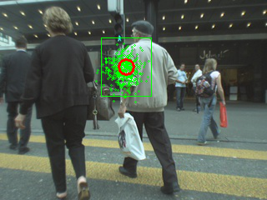
6: Challenge Problem (cont.)
ps5-6-a-2.png
Computer Vision @ GT

Slide 32
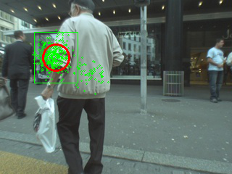
6: Challenge Problem (cont.)
ps5-6-a-3.png
Computer Vision @ GT

Slide 33
6: Challenge Problem Text response
I used the MDParticleFilter. I obtained a section of the man’s upper body for tracking. The challenge was that it is difficult to track after the man was lost in the street. But my filter was able to track the man afterwards. I did some parameter tuning to get it to work.
Computer Vision @ GT

